Slide 1


St. Francis Institute of Technology Department of Computer Engineering PRAKALP-2022 (Scrutiny Round)
Project Title: Face Mask Detection Using Live Video Streaming
Group:
Name | Roll No.
Yogita Likhi | 46
Sherwin Mathias | 53
Ujala Maurya | 54
Nithin Menezes | 58

Slide 2
Content
Introduction
Literature
Problem Statement
Proposed Solution
Work Flow of the system
Algorithm with Implementation details
Experimental Set Up
Data Set
Performance Evaluation Parameters
Validation with Test Cases
Results & Discussion
Conclusion
References

Slide 3
Introduction
COVID-19 pandemic is the most life-changing event which has startled the world since the year 2020.
Masks, Sanitizer and social distancing became the priority of each and every person.
A survey shows that 90% of people in India are aware of wearing a mask, but only 44% of them is wearing a face mask.
Face mask detection makes the process of checking face mask on a person fast and efficient. It can be deployed in malls, schools, college, etc.

Slide 4
Here we have proposed an automation system for detecting people who is not wearing a mask then in next step recognizing the face of that person for taking certain against him/her.
In our project we are using CNN based MobileNetV2 Architecture for Mask Detector Model. For live streaming as well as capturing of the faces we are using OpenCV along with Haar Face Detector. For Face Detection, we are using MTCNN Architecture model and Siamese Network Face Recognition which is a part of FaceNet algorithm.

Slide 5
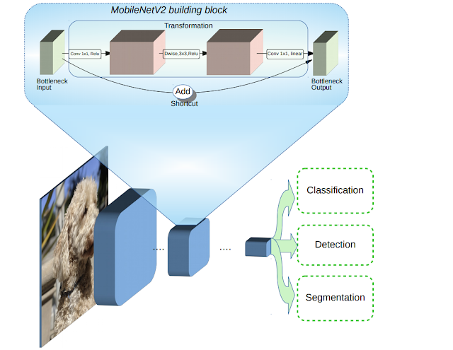
Literature
Fig 2.1 Overview of MobileNetV2 Architecture

Slide 6
Literature
Comparison of technique:
Figure [2.1] shows the overview of MobileNetV2 Architecture. MobileNetV2 builds upon the ideas from MobileNetV1 (previous version), using depth wise separable convolution as efficient building blocks. However, V2 introduces two new features to the architecture:
1) linear bottlenecks between the layers, and
2) shortcut connections between the bottlenecks.
Overall, the MobileNetV2 models are faster for the same accuracy across the entire latency spectrum. In particular, the new models use 2x fewer operations, need 30% fewer parameters. Also, MobileNetV2 is a very effective feature extractor for object detection and segmentation.

Slide 7
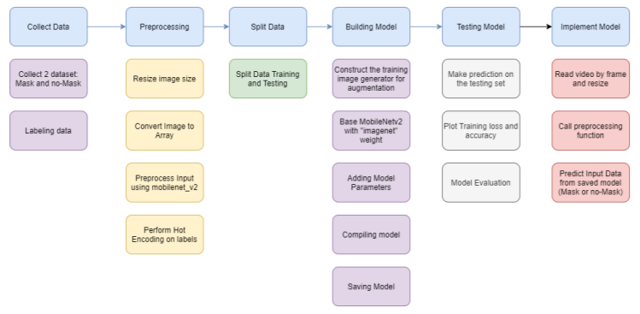
Fig: Face mask detection in Image 2.1 Face Mask Detection: 2.1.1 Face Mask detection in image:

Slide 8
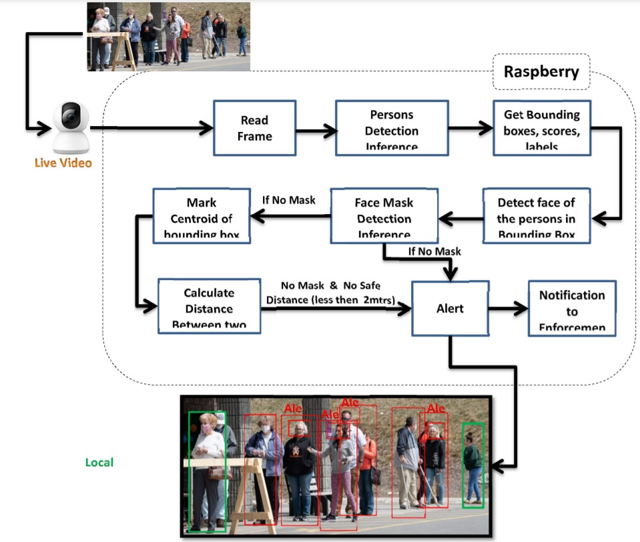
2.1.2 Face Mask detection in video

Slide 9
Problem Statement
To provide a system to monitor people who are not wearing mask by taking live video as input and detecting the people not wearing mask with a red box. The system should also be able to recognize that person and keep a track of the violation count and send him/her a warning through email or messaging system after a specific number of counts crossed.

Slide 10
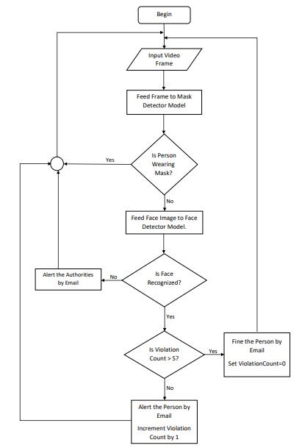
Work Flow of the system Fig: Workflow of our project

Slide 11
Algorithm with Implementation Details
MobileNetV2:
In our project we are using CNN based MobileNetV2 Architecture for Mask Detector Model. For live streaming as well as capturing of the faces we are using OpenCV along with Haar Face Detector.
FaceNet:
For Face Detection, we are using MTCNN Architecture model and Siamese Network Face Recognition which is a part of FaceNet algorithm

Slide 12
Experimental Setup
The system uses two datasets, one for training face mask detection model and other for training face recognition model.
The first dataset (for mask detection model) is taken from the Kaggle dataset which includes thousands of records. The data which has been collected labelled into two groups; with and without a mask.
Before the model creation, first we need to pre-processed the data i.e. resizing the images and then converting images into numpy array for further steps.
Then we split into two groups which are training data (80%) and testing data (20%). Each group is containing both of with-mask and without-mask images.
Next step is to build the face mask detector model with base model MobileNetV2, which consist of pictures of students with their namer and PID, and the last is saving the model for the future prediction process.

Slide 13
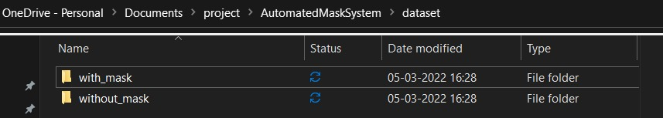
Fig1: Mask system dataset

Slide 14
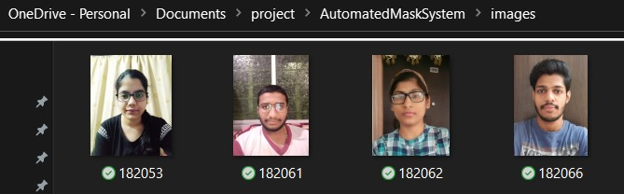
Fig2: Face recognition dataset

Slide 15
Performance parameters (definition and equations with ideal and worst case value should mentioned )
THIS PART IS LEFT

Slide 16
Validation with Test cases
Students with mask will be shown in green box and without mask will be shown with red box along with the student details and the violation count will be updated automatically.
Violations count of students are filtered based on Department, we can also view the recorded count of students yesterday and today and make a comparison.
The graph is also shown for the ease of understanding.
Notifications can be sent with an email to the student violating as a warning.

Slide 17
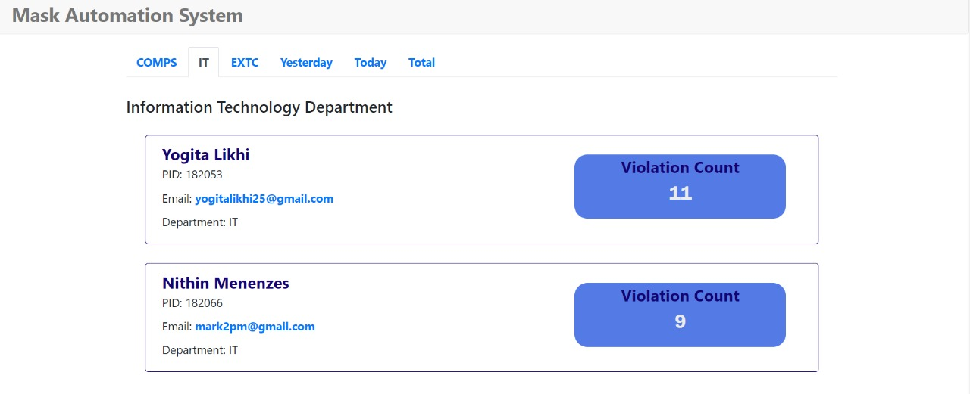
Fig1: Violation count of students in a particular department
Validation with Test cases

Slide 18
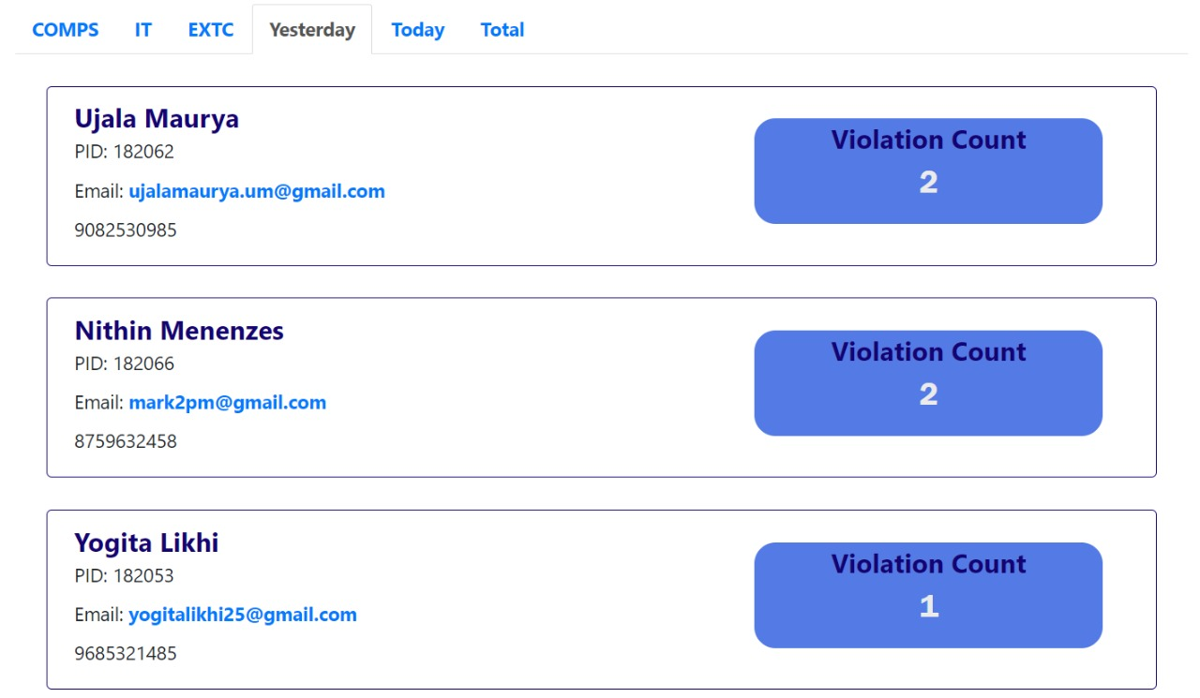
Validation with Test cases
Fig2: Violation count of students recorded yesterday

Slide 19
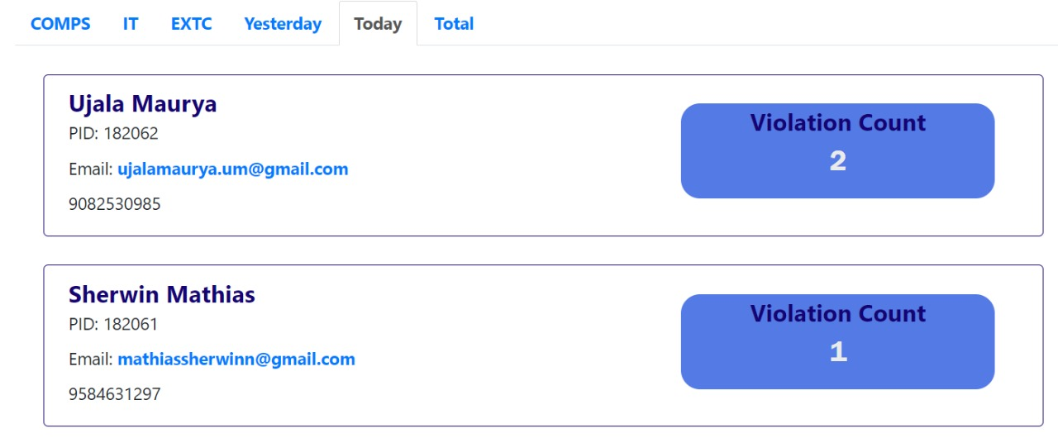
Validation with Test cases
Fig3: Violation count of students recorded today.

Slide 20
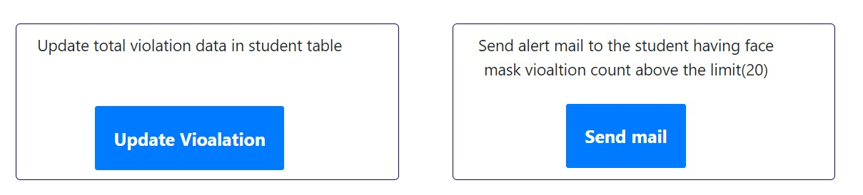
Validation with Test cases
Fig4: We can update violations and send email as a warning to the person

Slide 21
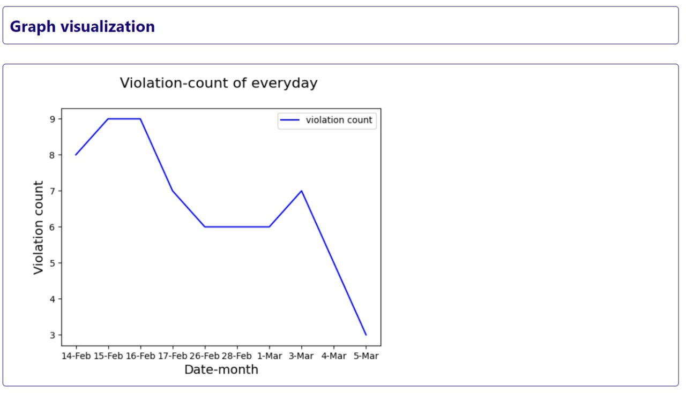
Validation with Test cases

Slide 22
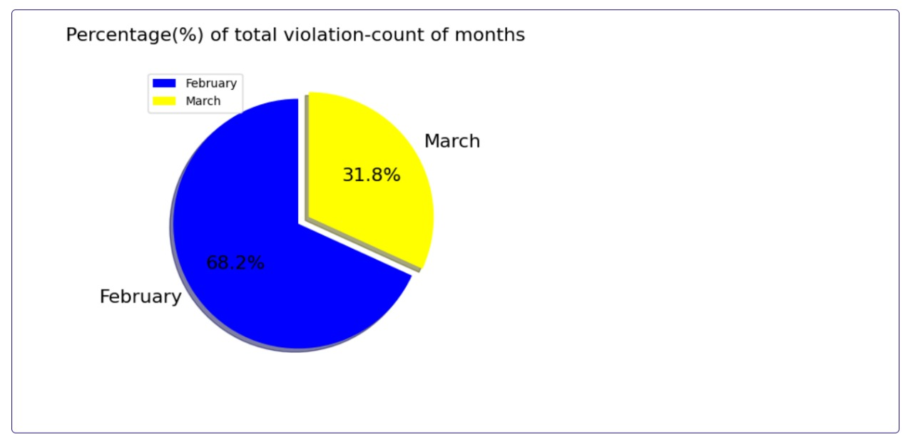
Validation with Test cases

Slide 23
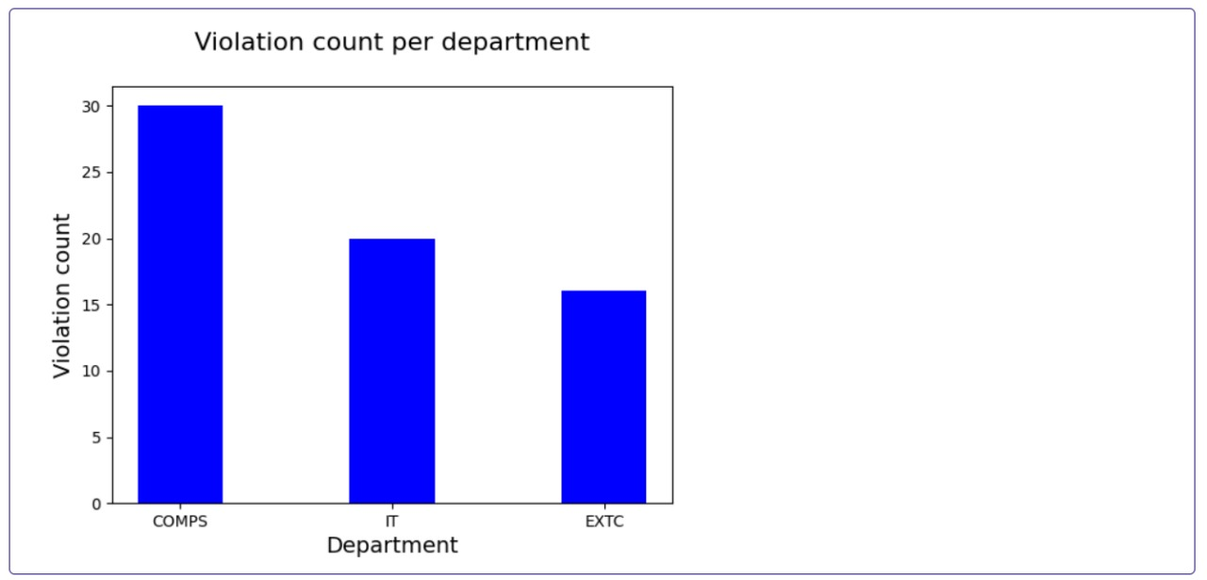
Validation with Test cases

Slide 24
Results and Discussions
To analyze our model with others, we have trained our model using MobilenetV2 and the same dataset from Kaggle. After training the model we have tested it and obtained it’s accuracy. The following table shows the analysis done.
Model | Dataset | Accuracy (in %)
Tensor Flow and Keras | Face Mask Detection dataset, Kaggle | 90.58
YoloV3 | Face Mask Detection dataset, Kaggle | 87.16
MobilenetV2 | Face Mask Detection dataset, Kaggle | 89
Table 6.1: Comparison between different models

Slide 25
Results and Discussions
If we compare the results shown in the table 6.1, MobilenetV2 performs better than YoloV3 but a little less than Tensor Flow and Keras. But if we analyze the results, MobilenetV2 still provides with efficient performance. The accuracy is still near the ranges if 90%.

Slide 26
Conclusion
In this presentation we have discussed the project and implementation of Face Mask Detection System.
We also discussed brief overview and working of MobileNetV2 model which will be used to create face mask detection model.
Using face mask detection system we can find out the people not wearing masks. These people can then be recognized via face recognition system.
Once the person is recognized he can be warned using the alert system via a message or mail. If someone is caught doing the same mistake more than five times he/she will be fined.

Slide 27
References
[1] “MobileNetV2: The Next Generation of On-Device Computer Vision Networks”, Mark Sandler and Andrew Howard, Google Research, Tuesday, April 3, 2018.
https://ai.googleblog.com/2018/04/mobilenetv2-next-generation-of-on.html
[2] Samuel Ady Sanjaya, Suryo Adi Rakhmawan, “Face Mask Detection Using MobileNetV2 in The Era of COVID-19 Pandemic”, 20 January 2021.
https://ieeexplore.ieee.org/document/9325631
[3] Shashi Yadav “Deep Learning based Safe Social Distancing and Face Mask Detection in Public Areas for COVID-19 Safety Guidelines Adherence”, July 2020.
https://www.researchgate.net/publication/343346690_Deep_Learning_based_Safe_Social_Distancing_and_Face_Mask_Detection_in_Public_Areas_for_COVID-19_Safety_Guidelines_Adherence

Slide 28
References
[4] Luka Dulcic, “Face Recognition with FaceNet and MTCNN”, 2018 https://arsfutura.com/magazine/face-recognition-with-facenet-and- mtcnn/
[5] Florian Schroff, Dmitry Kalenichenko and James Philbin, “FaceNet: A Unified Embedding for Face Recognition and Clustering”, 15 October 2015. https://www.cvfoundation.org/openaccess/content_cvpr_2015/html/Schroff_FaceNet_A_Unified_2015_CVPR_paper.html.
[6] Ivan William, De Rosal Ignatius Moses Setiadi and Heru agus Santoso, “Face Recognition using FaceNet (Survey, Performance Test, and Comparison)”, October 2019. https://www.researchgate.net/publication/339173834_Face_Recognition_using_FaceNet_Survey_Performance_Test_and_Comparison

Slide 29
References
[7] Edwin Jose, Greeshma Manikandan, Mithun Haridas and Supriya M H, “Face Recognition based Surveillance System Using FaceNet and MTCNN on Jetson TX2”, March 2019. https://www.researchgate.net/publication/333660229_Face_Recognition_based_Surveillance_System_Using_FaceNet_and_MTCNN_on_Jetson_TX2
[8] Arjya Das; Mohammad Wasif Ansari; Rohini Basak, “Covid-19 Face Mask Detection Using TensorFlow, Keras and OpenCV”, 05 February 2021
https://ieeexplore.ieee.org/document/9342585
[9] Stefanos Kanellopoulos, “Face Mask Detection using darknet’s YOLOv3”, 12 April 2021
https://towardsdatascience.com/face-mask-detection-using-darknets-yolov3-84cde488e5a1
[10] Face Mask Detection dataset, Kaggle
https://www.kaggle.com/andrewmvd/face-mask-detection?select=images

Slide 30
Thank you !!!
Q & A ??

